Slide 1
Philippians 2:1-4
Unity & Humility
Preached by David Harakal Amman International Church, Jordan (AmmanChurch.org) Uploaded by Dr. Rick Griffith • Jordan Evangelical Theological Seminary Files in many languages for free download at BibleStudyDownloads.org
Notes:
Tonight, we continue our study of Paul’s letter to the Philippians and begin chapter 2
Can’t have Unity with out Humility
The WAY we show humility and the unity that results from that differentiate us from other groups and religions.
As followers of Jesus, we do not practice humility nor seek unity for our benefit, or even for our church’s benefit, but to Glorify God

Slide 2
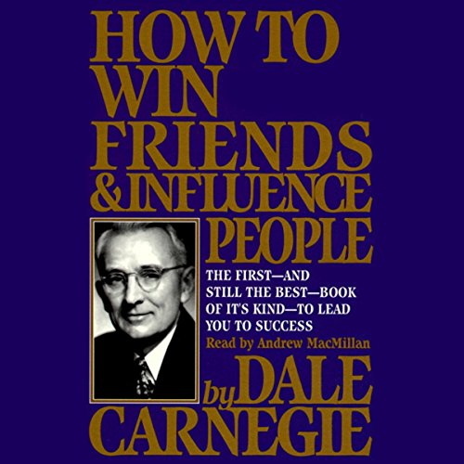
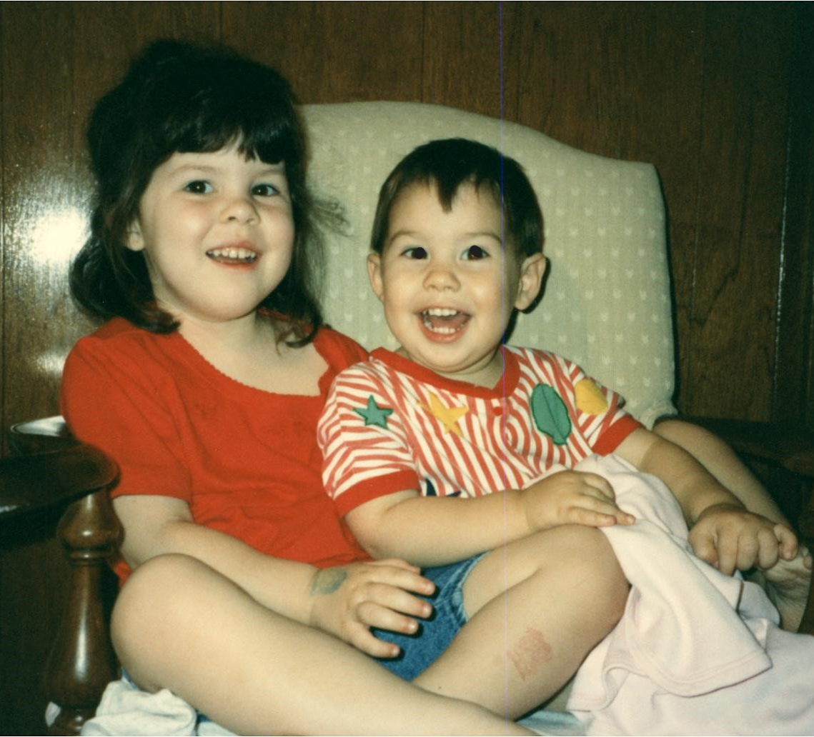
Me? Really?
Notes:
If you had told ANYONE that this guy (slide) would one day give a sermon (that alone would have been a non-starter) on Unity and Humility, they would have laughed at you. Or cried.
You know that book, “How to Win Friends and Influence People”? I read it as how to make friends and use them to my advantage.
So, what happened? How did I get from there to here, a shift from me to thee?
First I met this cute girl with a gentle spirit and a beautiful smile on a summer abroad trip in Oxford, England. This picture says a lot, doesn’t it?
Well, then this happened. Not quite sure what she saw in me, but happy that she did!
Then these two bounced in.
God used marriage and children to start chiseling away at my stone heart.

Slide 3
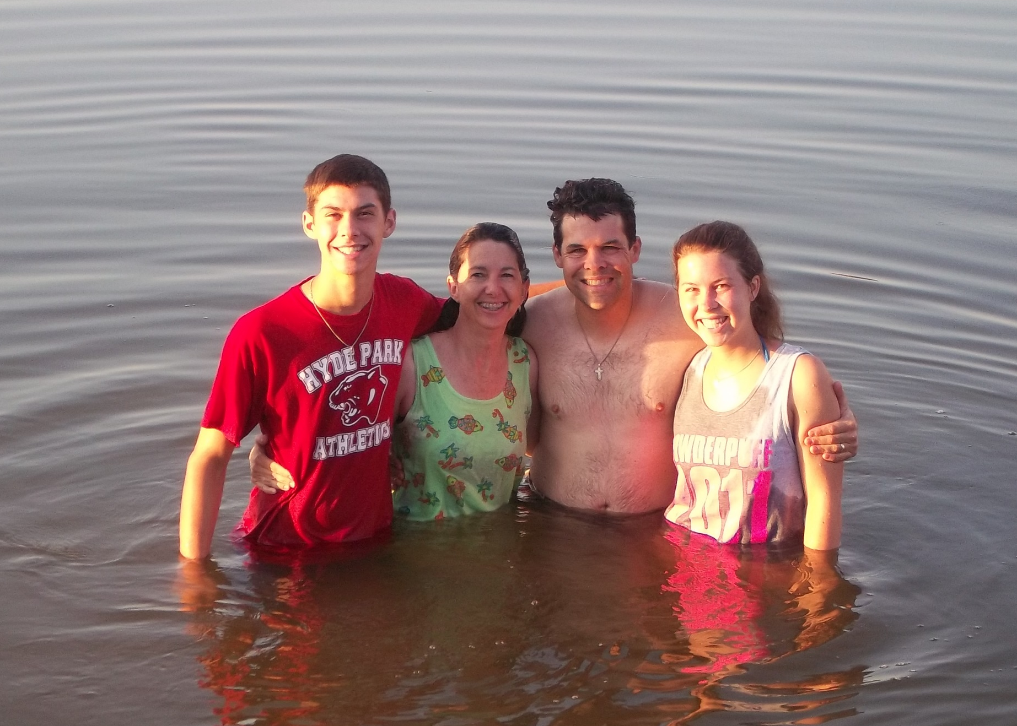
Ultimately, this happened
Notes:
I do a lot of things very quickly. Giving my life to Jesus was not one of them.
Looking back, I can see myriad ways he was pursuing me. There wasn’t a Sunday that I didn’t miss church, and I prayed. A lot. God knew what I wanted ☺ I kept God on the margins.
In my 40s, ~20 years into marriage and about that long into a corporate finance career, with teen-aged children, I gave my life to Christ. Suzanne rededicated her life.
< Click> Then this happened. Notice who’s wet and who’s dry. Yep, got it backwards. As infants, we baptized them. As adults, they baptized us.
None of this would have happened without me relinquishing my life to Jesus.
(( First Point )) That’s what today’s verses teach us and why I shared my story – when our lives are changed by Jesus by the work of the Holy Spirit, we look different – we are different

Slide 4
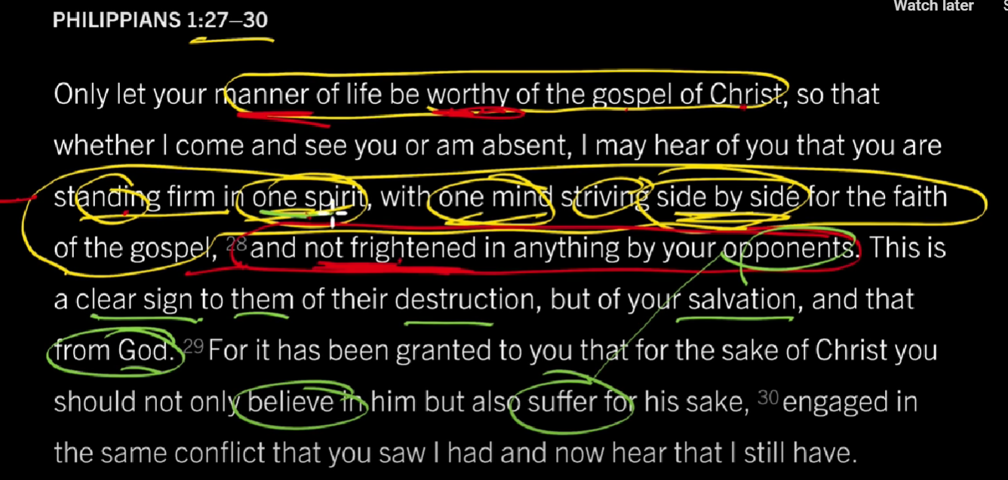
Thank you, John Piper!
Notes:
Thank you to Dr. Piper.

Slide 5
7 points
Through the Holy Spirit we become a new creation
God gives us each unique gifts to create unity
God sends a Helper
God offers us joy
We have to act
How we act differentiates us
1-6 will glorify God and benefit us
A promise and commands
#) Where are we?
Notes:
Let’s dig in. I will have 7 points for you today
1 – my story. Not about what I have done but what he has done and is going in and through me. Born again.
5 – even if you are on the right track, you are still going to get run over if you just sit there
6 – No just doing it that matters, but how
<Click> Paul gives us a promise and a command, but in reverse order – the command comes out of the promise.
Let’s pray
Let the words of my mouth and the meditation of my heart be acceptable in your sight, O LORD, my rock and my redeemer.
Open ears, minds and hearts to what you would speak through me.

Slide 6
Philippians 2:1-4
So if there is any encouragement in Christ, any comfort from love, any participation in the Spirit, any affection and sympathy, complete my joy by being of the same mind, having the same love, being in full accord and of one mind. Do nothing from selfish ambition or conceit, but in humility count others more significant than yourselves. Let each of you look not only to his own interests, but also to the interests of others.
Notes:
Someone read – give folks a break from my voice.

Slide 7
Philippians 2:1-2a
So if there is any encouragement in Christ, any comfort from love, any participation in the Spirit, any affection and sympathy, complete my joy . . .
So ≈ therefore
What is the “therefore” there for?
2) Gifts → Unity
Notes:
The beginning would seem to be a good place to start.
Paul loves to use if-then, so, therefore, and then put a bunch of words between that and his point

Slide 8
Philippians 2:1
So . . .
Phil 1:27-28 Only let your manner of life be worthy of the gospel of Christ, … you are standing firm in one spirit, with one mind striving side by side for the faith of the gospel, and not frightened in anything …
Eph 4:1 I therefore, a prisoner for the Lord, urge you to walk in a manner worthy of the calling to which you have been called
2) Gifts → Unity
Notes:
No chapter breaks in Paul’s letters, so this would have flowed right from the passage on which Pastor Dan preached last week.
1:27 can be summed up in Eph 4:1

Slide 9
Philippians 2:1-2
So if there is any encouragement in Christ, any comfort from love, any participation in the Spirit, any affection and sympathy, complete my joy –
be of the same mind, have the same love,
be in full accord and of one mind.
(Sorry, no Greek or Hebrew today)
2) Gifts → Unity
Notes:
What does that mean?

Slide 10
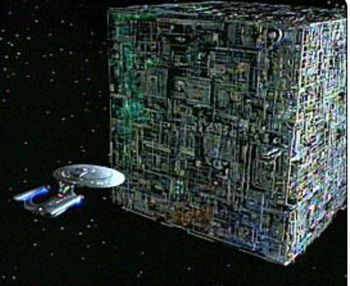
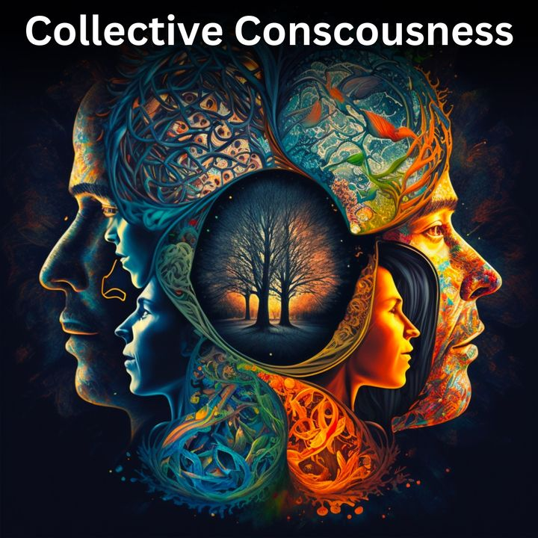
Philippians 2:1-2
… be of the same mind, have the same love, be in full accord and of one mind.
We do not have the same intelligence
We do not have the same emotional intelligence
Some are artistic. Some can’t draw a straight line.
Do we all share the same desire to serve Jesus?
2) Gifts → Unity
Notes:
Really, we all have to be the same?
Of course not.
If we were all the same it wouldn’t be glorifying to God. Rather boring.
God made us different to glorify himself, and all the more when all of us different people are living in unity.
But we are called to have the same desire to love and serve Jesus
We are called to be “all in”
What might that cost?

Slide 11
Philippians 2:1-2
At what cost?
Home country
With extended family
Familiar culture
Land of our family’s heritage
Our pride
Our identify in accomplishment
We are a community with little in common but Jesus
AIC is a tiny hint of what heaven will be like
2) Gifts → Unity
Notes:
Almost all of us have either left the world we knew, or our families have in 1-2 generations. Why?
We have to look different from the world.
Giving up our pride reflects the humility he askes.
Giving up identity in our accomplishments opens the door to unity. Does not mean not to accomplish, but not to seek our identity in our individual accomplishments, but more on that later.

Slide 12
1 Corinthians 12:4-7
Now there are varieties of gifts, but the same Spirit; and there are varieties of service, but the same Lord; and there are varieties of activities, but it is the same God who empowers them all in everyone. To each is given the manifestation of the Spirit for the common good.
2) Gifts → Unity
Notes:
We are given all of these different gifts, all of our differences, to contribute to unity in the body.
Can you do this on your own? Use your gifts for the common good? Love your neighbor? Me neither.
(( Second Point )) God gives us unique gifts not in spite of our unity but to lead to unity

Slide 13
Is God With Us?
?
So if there is any encouragement in Christ, any comfort from love, any participation in the Spirit, any affection and sympathy.
If → A challenge:
Are you encouraged in Christ?
Do you find comfort from God’s Love?
Do you know the Holy Spirit’s presence?
3) Helper
Notes:
Only 10 minutes in and we are already on the second word. I hope I’m not going through the passage too quickly.
Don’t worry, we will be done before morning.
<Click> If is more of a challenge – so, how are you doing on these things?

Slide 14
We are NEVER alone
<Therefore, because> there is encouragement in Christ, comfort from love, participation in the Spirit, affection and sympathy.
Praise God we do not have to do this on our own.
I will send you the Helper (Comforter) from the Father. The Helper is the Spirit of truth who comes from the Father (John 15:26).
Therefore, because. Ok. So what?
3) Helper
Notes:
Christianity is unique in that God comes to us.
He models humility in sending the Holy Spirit to live with us messed up people!
Other religions – work hard, do all the right things, make all the right sacrifices, say the right prayers at the right time, and it MAY be enough
Not so for the Christian
<CLICK>God knows we cannot do this on our own, and he WANTS us to succeed.
I’ll speak for myself. w/o HS NO WAY I would not pray every day to love & serve SRH better (btw, now working 100% yet, but I wouldn’t even have the DESIRE to want to server her!))
I would not love y’all
Leave the comforts of home? Seriously? We had it made! Late model DINKS. (explain)
Me? Preach? And about unity and humility? You have got to be kidding.
I was not complicated. I got my MBA and was on the fast track at a Fortune 10 ($100B company) to get rich.
Not about what I have done, but what God has done and is doing in and through me
(( Third Point )) We are not alone. God knows we cannot do this in our fallen state, so he intervenes
<Click>
There’s encouragement. OK
And the spirit is with us. Good
We receive affection and sympathy. That’s nice.
So . . .

Slide 15
So What?
So if there is any encouragement in Christ, any comfort from love, any participation in the Spirit, any affection and sympathy, complete my joy by being of the same mind, having the same love, being in full accord and of one mind.
4) Joy
Notes:
Writing from prison, possibly death
He is not looking for them to break him out of jail to complete his joy.
He is not looking for them to bring him mansef every evening and mana2ish every morning to complete his joy.
He is reliving the Philippian church being the church to complete his joy. In prison!
C.S. Lewis in “Out of the Silent Planet” - A pleasure is full grown only when it is remembered.
(( Fourth Point )) – Not just a rule because God likes rules, or just wants the church to be nice – he wants us to find deep and lasting joy in and through the church, the body of believers

Slide 16
Have you dedicated your life to Jesus Christ?
Do you live in the power of the Spirit?
Does the Spirit bring you peace in the midst of your storms?
If not, PLEASE talk to an elder or to someone in your life who has given their life to Jesus
Without the Holy Spirit, just skip verses 3 & 4
5) Act
Notes:
1) – Sitting in a church doesn’t make you a Christian any more than sitting in a garage makes you a car. So this question is relevant to a church. I sat in church for 40 years before I became a Christian.
3) Can you decide you are happy to some degree, sometimes, if things are just right? Are you a naturally calm person?
Are there people who look altruistic and have it all without God? Why are so many famous people which huge Social Media followings abuse drugs or commit suicide?
5) Unless the Holy Spirit changes your heart, you cannot glorify God. You can’t. Not just won’t, but can’t. You will do these things for you. Your heart will be wrong. We can’t do 3 & 4 properly. Let’s go there.

Slide 17
We Have to Act
Do nothing from selfish ambition or conceit, but in humility count others more significant than yourselves.
Let each of you look not only to his own interests, but also to the interests of others.
ME → THEE
5) Act
Notes:
Any of you want to be radical? This life is radical.
(( Fifth Point )) Because of these things, we have work to do . Though the Holy Spirit is working in and through us, we have to do something. The church does not exist to sit and receive. We are called to act.
We act BECAUSE we serve a loving father, not to earn that love. Parents, I pray this is what you teach your children. We expect them to obey and to love their siblings and their friends because of the great, sacrificial love we show them.
<Click> Replace “me” with “thee”, both “thee” (point to room) and “thee” (point to heaven)

Slide 18
Phil 1:3-4 ESV
Do nothing from selfish ambition or conceit, but in humility count others more significant than yourselves.
Let each of you look not only to his own interests, but also to the interests of others.
Phil 1:3-4 ODV
Do everything from selfish ambition and conceit, and in humility count yourself more significant than others.
Let each of you look not only to his own interests, and not to the interests of others.
6) Act differently
Notes:
I have taken this passage out of the English Standard Version.
I used to live by another version.
<Click> The Old David Version
<Click> Read ODV
(I don’t’ think most of you would have liked me.)
I was actually pretty generous and helpful, but more for how it looked or what it gained.
My life looked good on the outside, but my motives were wrong. The inside was rotten.
I was a LITTLE better when I met Suzanne. PTL for her long-suffering heart! Married 34 years on the last day of the retreat, so please offer her your condolences.
I say this to offer hope that God can and does change lives. Miracles aren’t only healing or getting a visa.

Slide 19
Phil 1:3
Do nothing from selfish ambition or conceit, but in humility count others more significant than yourselves.
False Humility = Pride
Don’t belittle the gifts God gave you
6) Act differently
Notes:
Let’s look a bit at humility.
What this is NOT is false humility. <Click> <Click>
God gave me above average intelligence. That’s a gift in which I can claim no credit. If I belittle that intelligence, I dishonor God, the giver of that gift
Give God glory for your gifts. Your unique gifts.
Does not mean go to someone less wise, less intelligent to you for wisdom and that is somehow humble. No, that’s silly.
Don’t seek financial advice from someone with a string of bankruptcies living in a box to make them feel good. That’s unwise
But DO honor Jesus in them. Honor God’s value of each person as his image bearer. Help people find the gift they can give back to God if they don’t know it. Celebrate it if they do.
But DO count others more significant than yourselves
Dan will build on the humility of Jesus next week

Slide 20
Luke 14:10-11
But when you are invited, go and sit in the lowest place, so that when your host comes he may say to you, ‘Friend, move up higher.’ Then you will be honored in the presence of all who sit at table with you. For everyone who exalts himself will be humbled, and he who humbles himself will be exalted.”
But when you are invited, go and sit in the lowest place, so that when your host comes he may say to you, ‘Friend, move up higher.’ Then you will be honored in the presence of all who sit at table with you. For everyone who exalts himself will be humbled, and he who humbles himself will be exalted.”
6) Act differently
Notes:
We are NOT being asked to do an impossible task. God doesn’t do that.
<Click>
I do this in meetings – sit on the edge and wait to be invited to the table (when culturally appropriate). Try it! Note: Sometimes you are left there
If “invited to the table” you are immediately elevated in your role which adds weight to your statements
If not, you are recognized as a team player not trying to elevate yourself.
He knows we need encouragement via reward

Slide 21
1 Peter 5:6-7
Humble yourselves, therefore, under the mighty hand of God so that at the proper time he may exalt you, casting all your anxieties on him, because he cares for you.
6) Act differently
Notes:
Proper time – God’s proper time, not mine.
Elizabeth story
If you doubt care, remember he sent is son to die for your sins.

Slide 22
Humility is not
thinking less of yourself, but thinking of yourself less.
—C.S. Lewis, Mere Christianity
6) Act differently
Notes:
Someone down in the dumps can be just a prideful as someone entitled in a fancy car who cuts you off in traffic.
Humility is not telling yourself you are less than you are (false humility).
True humility – using your gifts to meet the needs others. How much of your time to spend thinking of you?
Not saying you need to go around in a burlap sack and starve. Needs of others take many forms, time often being the greatest need.

Slide 23
Humility Enables us to Love
Do you love your neighbor?
Different race or caste?
People group with historical animosity?
Someone who wronged you?
A family member who has abandoned you?
6) Act differently
Notes:
Much of Philippians has been about how to love, and these two passages continue that theme, with how to achieve that love.
Race – I grew up quite racist, so I get understand this evil.
Historical animosity – we saw much of this in Lebanon. The lack of love for other groups fueled a 15 year civil war, and the heart behind that war is still there. Shia, Suni, Orthodox, Catholic, Druse. Tribalism was well already well entrenched in this region in Paul’s day
Wronged you? – Rick’s Sermon

Slide 24
What kind of love?
Elevation
Do nothing from selfish ambition or conceit, but in humility count others more significant than yourselves.
6) Act differently
Notes:
Love = want good for them. Happy when it comes, even if at your expense.
(( 6th Point )) – HOW we show love and create unity is important, because it shows the power of God in our lives.

Slide 25
This is not impossible
Luke 6:35 - But love your enemies, and do good, and lend, expecting nothing in return, and your reward will be great, and you will be sons of the Most High, for he is kind to the ungrateful and the evil.
Matt 6:16 - In the same way, let your light shine before others, so that they may see your good works and give glory to your Father who is in heaven.
My Glory → God’s Glory
My Desires → God’s Desires
7) Our Good & God’s Glory
Notes:
SHIFT focus from me to God, from my glory to his Glory, from my desire to his desire
Lords prayer at communion last week – THY will be done, on earth as in heaven. Have to know what his will is.
(( 7th and final point )) We are rewarded for this. Yes, doing it because God says so is reason enough, but God doesn’t want us to be obedient little robots only. 1 Peter 5:7 – our heavenly father cares for us. Matthew 6:8 – he knows what we need before we ask. He has rewards for us when we shift our focus. <Click>

Slide 26
Lenten Challenge
Who don’t you like? Do something nice for them.
Who annoys you? Pray for good for them.
Not for them to stop annoying you
Galatians 5:22-23a - But the fruit of the Spirit is love, joy, peace, patience, kindness, goodness, faithfulness, gentleness and self-control.
Notes:
Might be simply saying something nice to them. Anonymously or otherwise
Going back to the beginning. We are called to “be the church”. As our song sang, will they know Amman International Church worships the God of the Universe by our love not just for each other, but for people who are hard to love?
Notice “and” – it’s all of them. And notice they are gifts, not tasks. Does your life reflect the Galatians passaged? If not, invite the holy spirit to make you into the person he made you to be.

Slide 27
7 checkpoints
Are you a new creation in Christ?
Do you use your unique gifts to create unity?
Is the Holy Spirit active in your life?
Do you find joy in obedience to God’s call?
Do you actively purse unity?
Do you pursue unity humbly?
Do you seek God’s glory through you?
Are we as a body
and are you as a person characterized by love?
Notes:
How are we doing?
2) Do you use your unique gifts to shift focus from yourself to others?

Slide 28
Closing Prayer
Notes:
Holy Spirit, without you, this ask is impossible. We are fallen people who cannot be the church you ask us to be, or the individuals you want us to be, for our good and your glory, without you.
But with you, we can glorify the father by humbly loving and serving others the world or our experience tells us are unworthy
Because you encourage us, Jesus, and from you we receive encouragement and comfort in love from the Holy Spirit, complete OUR joy as we live and work and strive together towards one desire, to love you and serve you.
Help us look different, that people see something different in the way we act with a heart for others’ interests instead of our own, that we value them above ourselves, that we are devoid of selfish ambition or conceit.
Lord, please help us trust you to provide our needs to free us to live the other-centered life you call us to lead. Amen.

Slide 30
NT Preaching link at BibleStudyDownloads.org
Get this presentation for free!
Notes:
NT Preaching (np)

